Slide 1
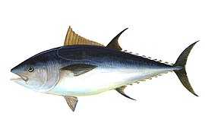
70 cm

Slide 4
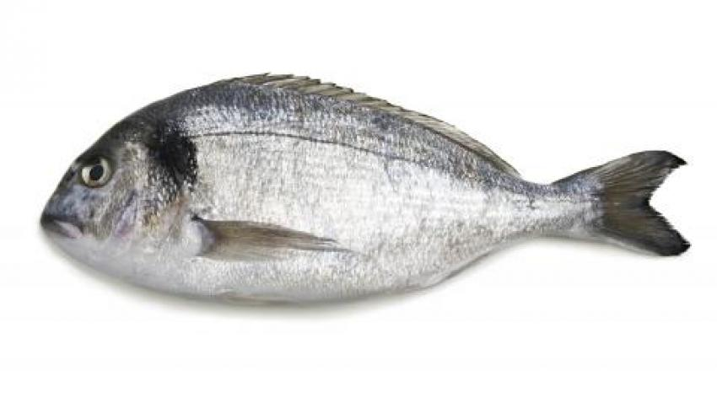
19 cm

Slide 5
11 cm

Slide 6
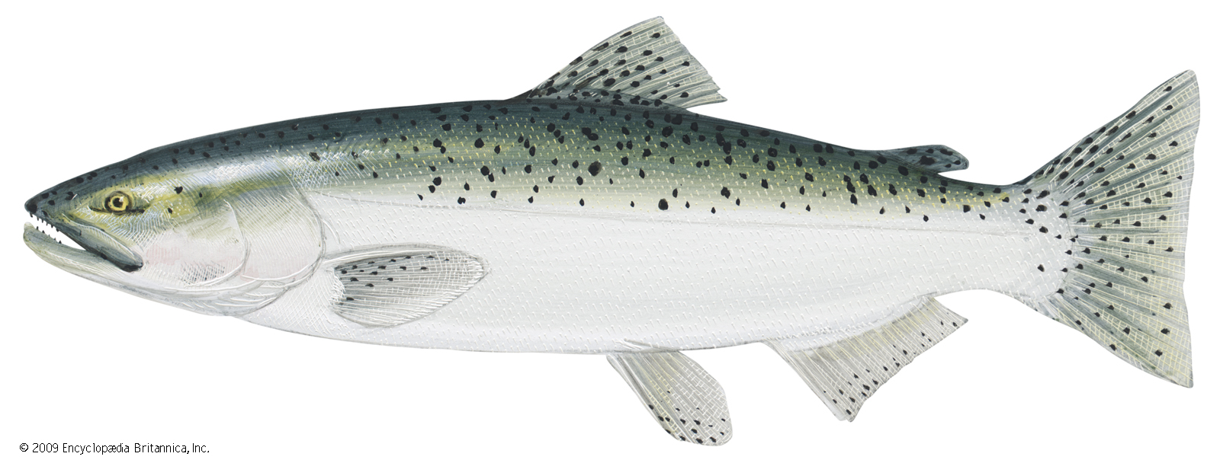
55 cm

Slide 7
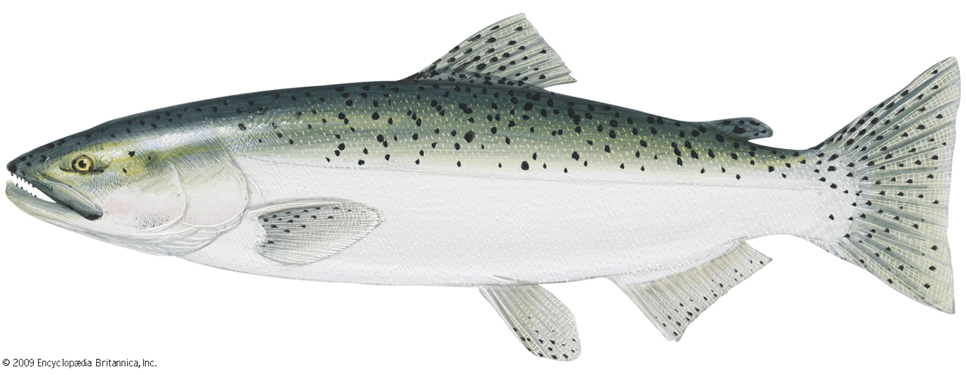
55 cm

Slide 8
55 cm

Slide 9
27 cm

Slide 10
27 cm

Slide 11
38 cm

Slide 12
38 cm

Slide 13
38 cm

